Slide 1

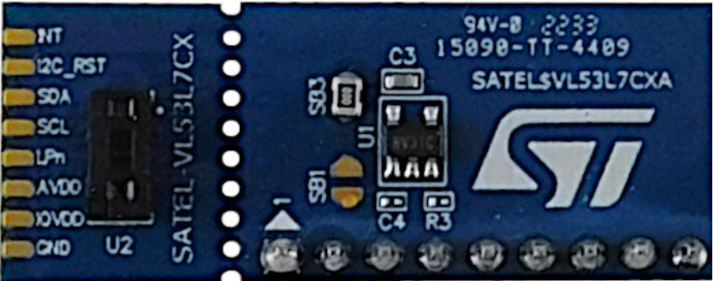
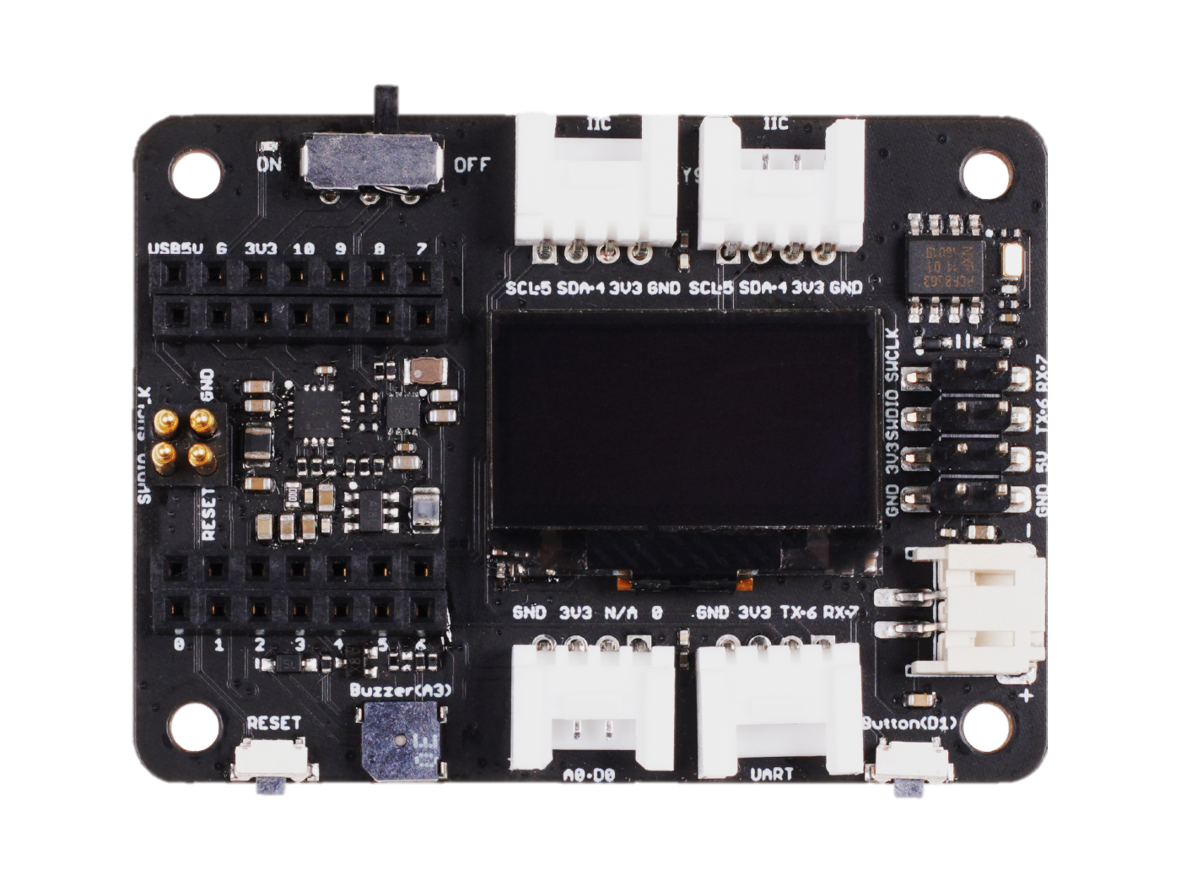
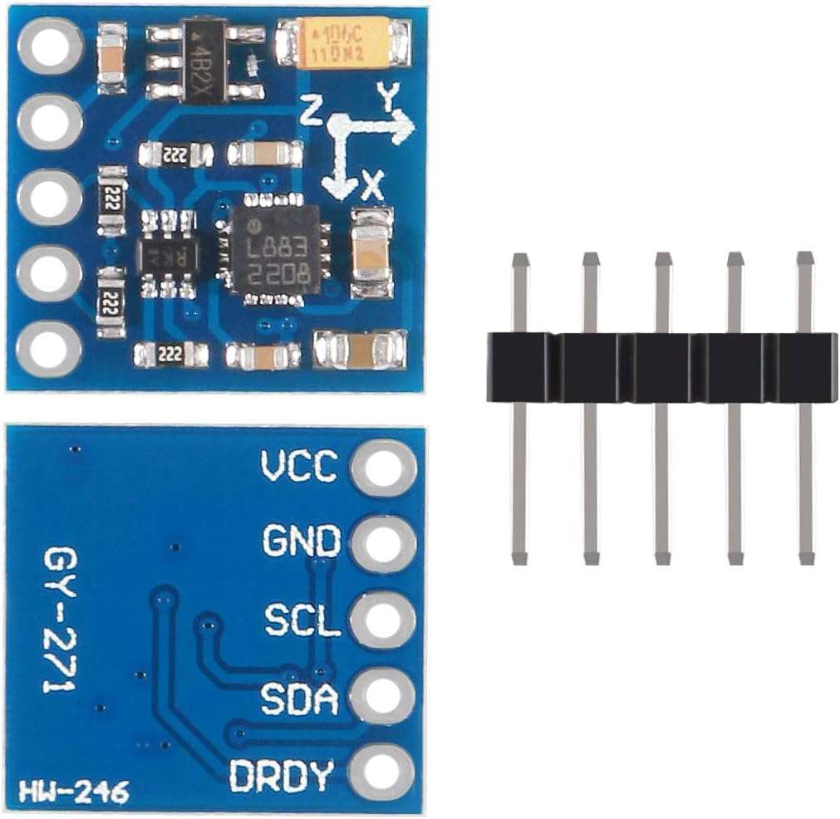
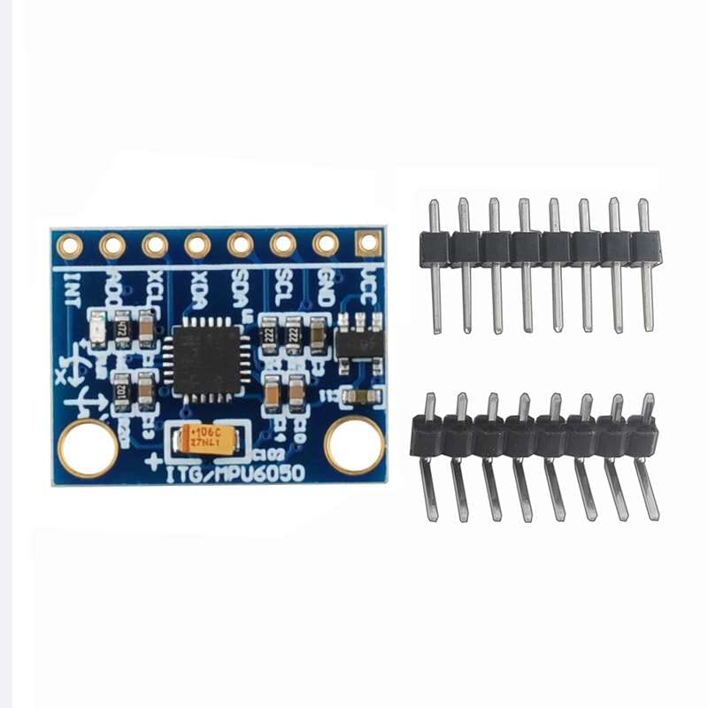
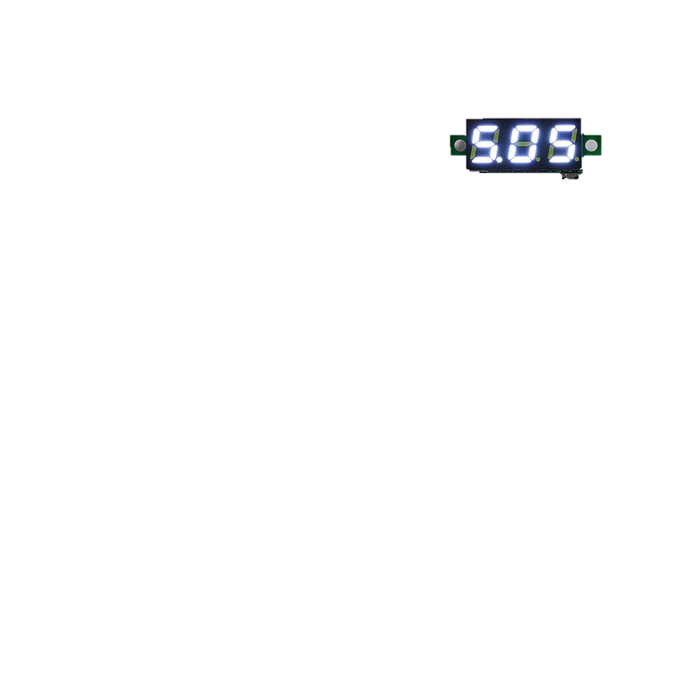
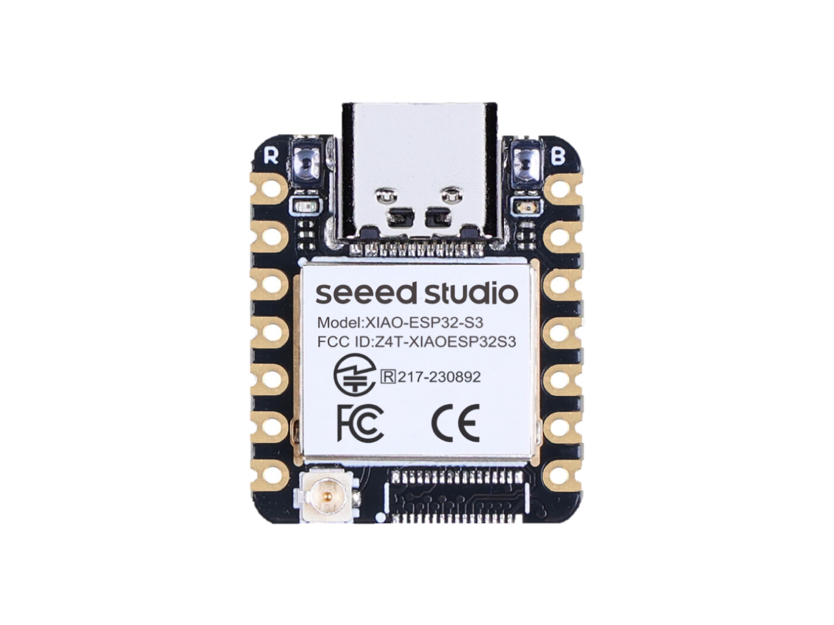
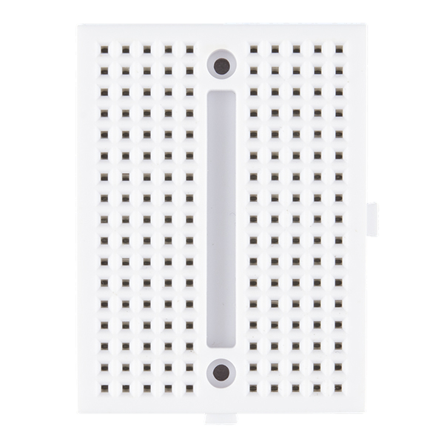
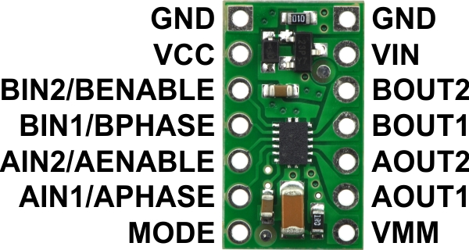
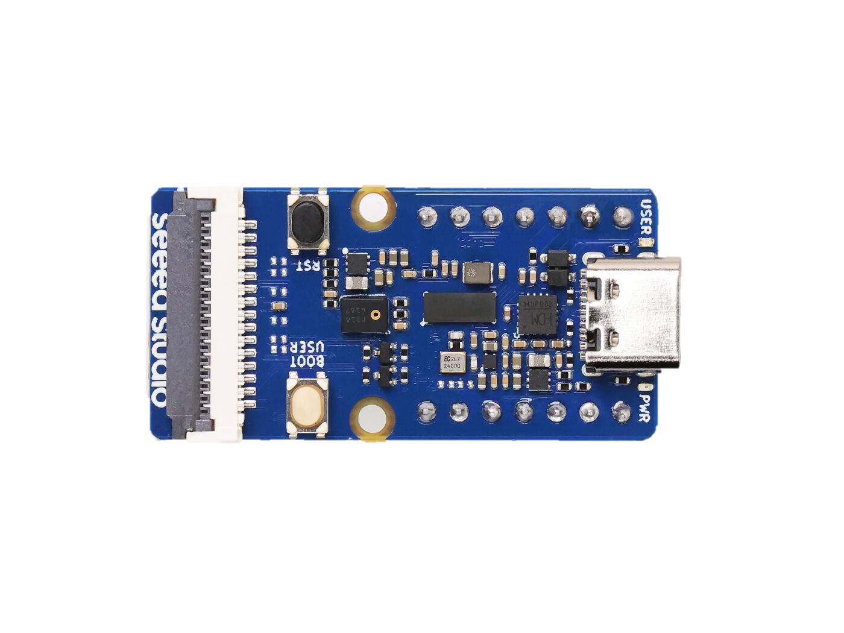
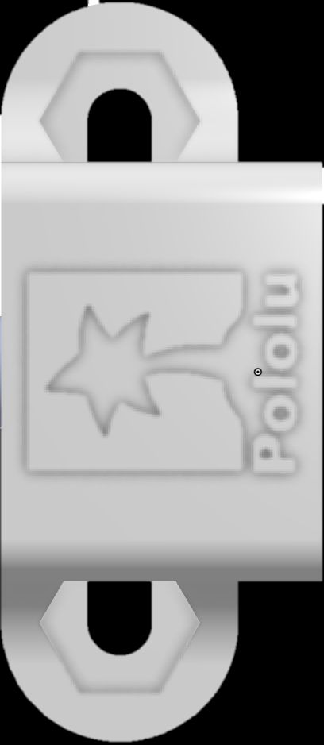
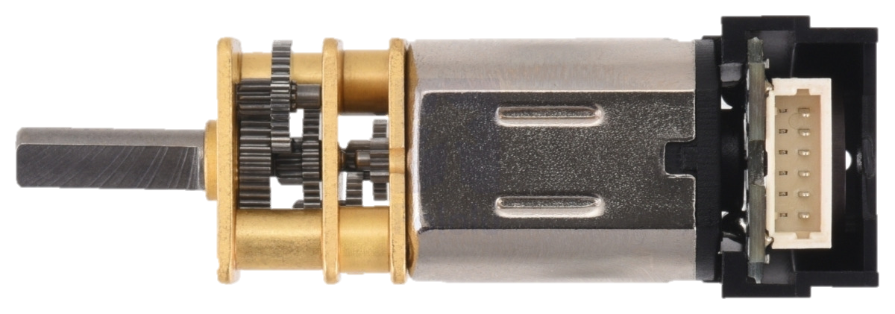
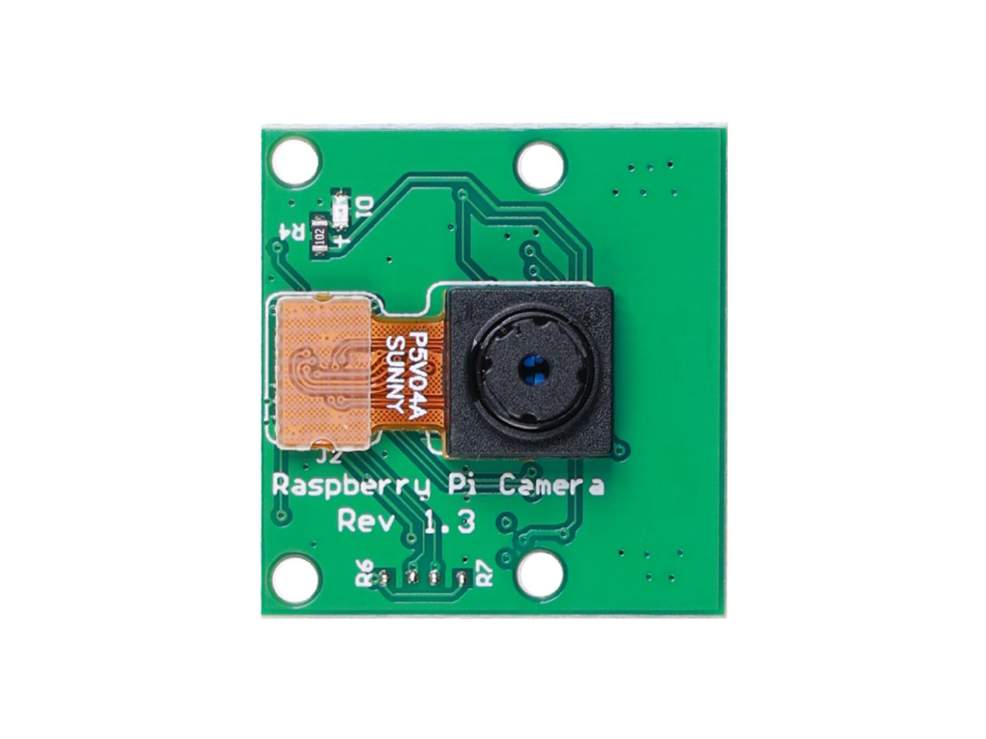
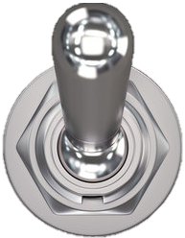
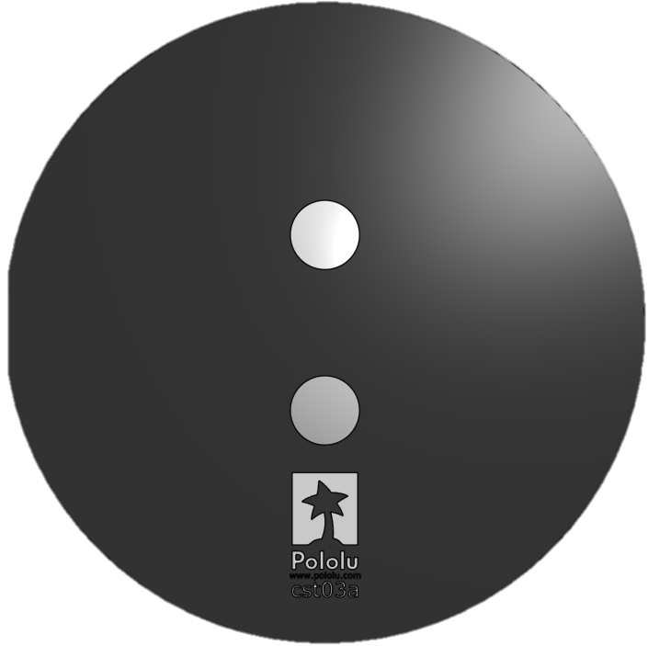
Parts
Wheel

Slide 2
Current Footprint
12 cm by 10 cm

Slide 3
Full Layout
NB
NB
NB
Wheel
Wheel
Wires
Strap
Strap

Slide 4
Full Layout – Starting Out
NB
NB
NB
Wheel
Wheel
Wires
Strap
Strap

Slide 5
Top
Wheel
Wheel
Wires

Slide 6
Cross Bar

Slide 7
Bottom
Wires
Strap
Strap

Slide 8
Create new document
Create variable studio
Paste in from excel

